Slide 1

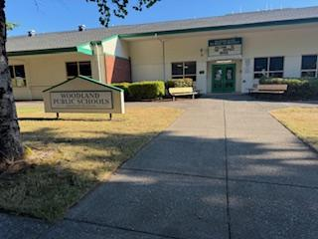
Facilities
Summer 2025
Goals & Accomplishments
August 15, 2025

Slide 2
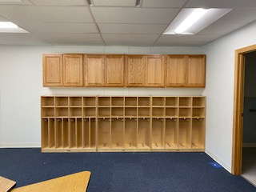
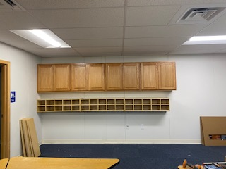
GOALS for Maintenance Crew:
Paint CES principal’s office
WMS bathroom and locker room stall replacements
WMS Yellow Hall painting
Fix and paint two portables at WMS
Carpet repairs
Clean and repair gutters
Repair fridge floor at NFES
Annual floral cooler and floral walk-in maintenance
Change sink filter system in room 1409 at HS & in floral shop
Replace HVAC filters
Installation of bird netting/bird spikes outside room 1409
Room moves
Complete 60 work order requests
NFES new portable cabinets and cubbies installed by Maintenance

Slide 3
Maintenance Crew ACCOMPLISHMENTS:
Painted CES principal’s office
Painted Portable 6 at CES
Moved preschool from NFES to CES Portable 6
Removal of carpet:
  CES: Rooms-203, 204, 207, 208, 209, 212, & 213
  NFES: Rooms-104, 105, 112, 212
WMS bathroom and locker room stall replacements
Painted interiors of both principal and vice-principal offices at WMS
WMS Yellow Hall painting
Fixed and paint two portables at WMS
Cleaned and repaired gutters
Repaired fridge floor at NFES
Completed annual floral cooler and floral walk-in maintenance
Helped dig trench to repair irrigation at WHS
Installed whiteboards in classrooms
Replaced the water heater in Portable 12 at CES
Change sink filter system in Room 1409 at HS & in floral shop
Replace HVAC filters
Installation of bird netting/bird spikes outside room 1409
Room moves
Hung brackets for Tech Dept to hang new smart tvs
Replaced all lights throughout the district buildings
Got vans fixed after vandalism
Built cubbies for rooms 106 and 110 at CES
Moved two loads of bark chips from NFES
Installed new windows at NFES
Fixed freezer at WMS
Ran string line for playground chips at CES
Delivered curriculum to various locations
Complete 60 work order requests
  Building stages, cleaning ice machines, moving rooms
Became aerial lift certified on both the scissor lift and boom lift

Slide 4
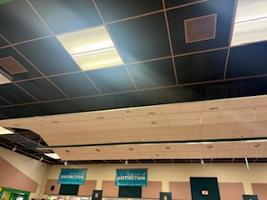
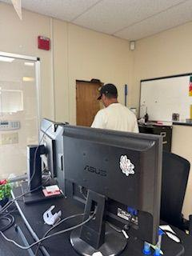
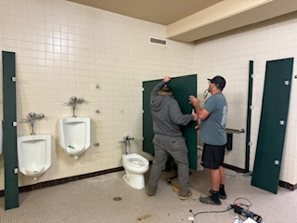
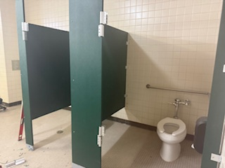
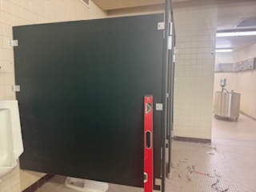
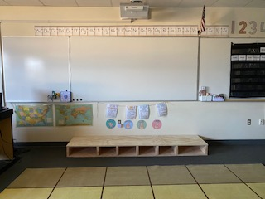
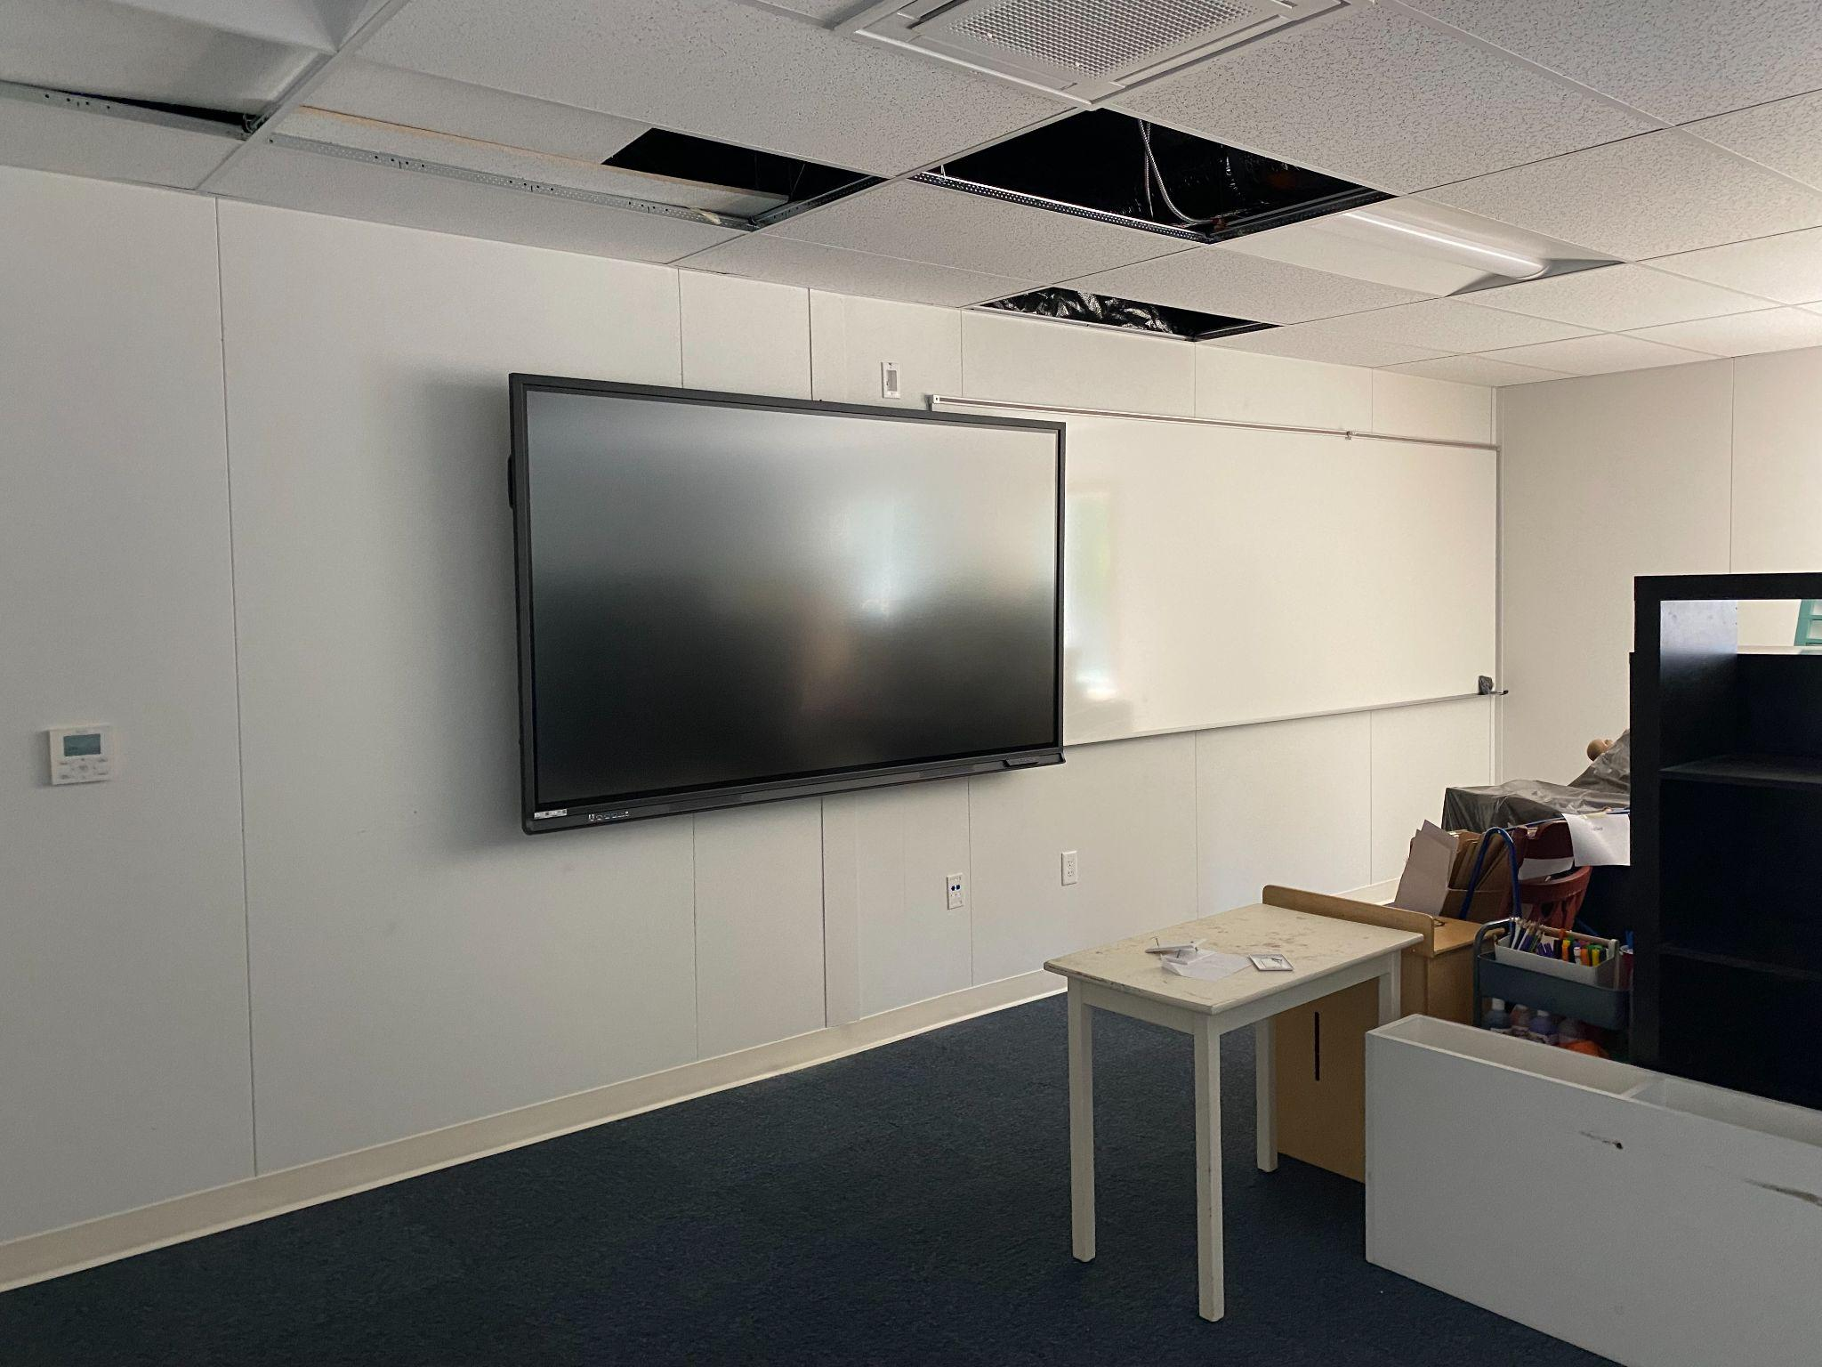
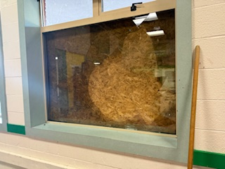
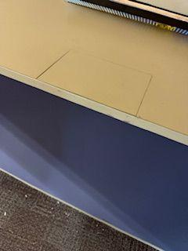
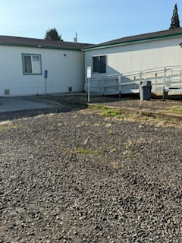
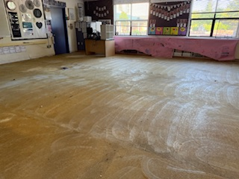
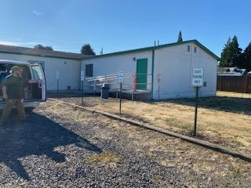
Maintenance Accomplishments
Replaced WMS Cafeteria Lights
WMS Green Gym, Boys’ locker room, bathroom stalls replacement
Built a stage for a classroom at NFES
Worked with Tech to hang new smart tvs
Removed carpet in all classrooms at NFES and CES
Replaced staff parking signs at TEAM after vandalism occurred
Replaced WMS Commons window due to vandalism
Repaired the office countertop at NFES

Slide 5
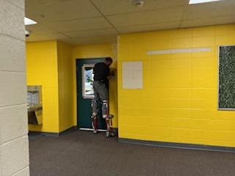
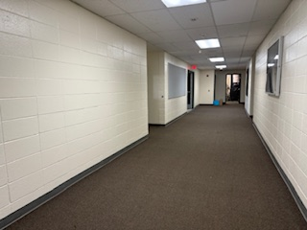
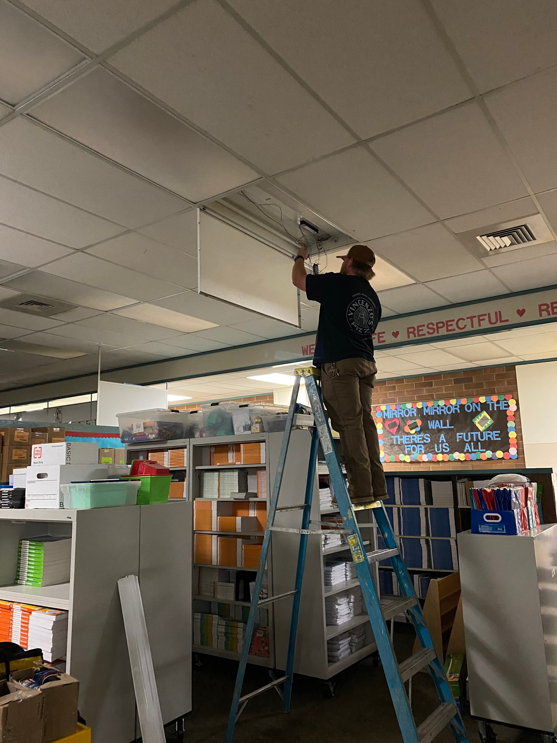
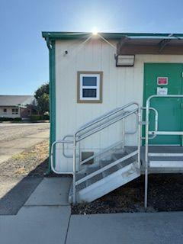
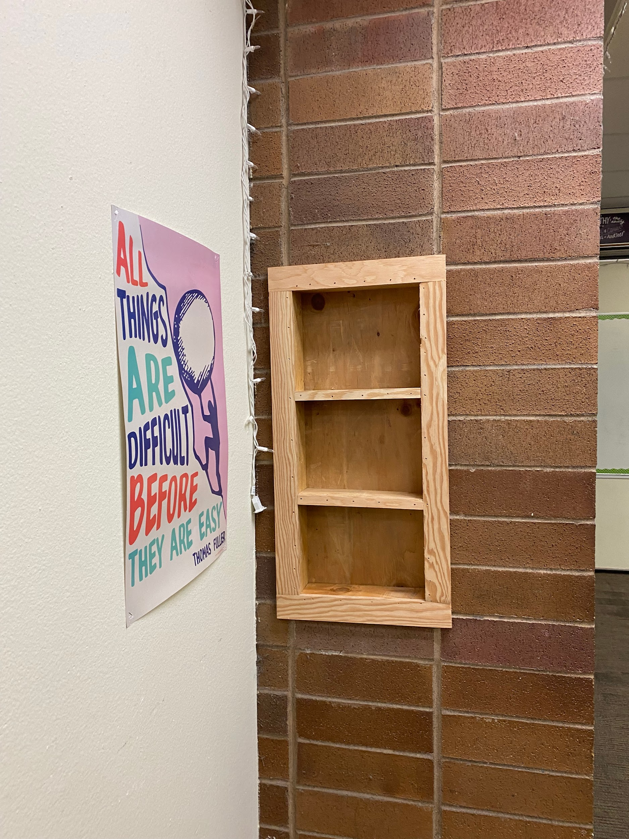
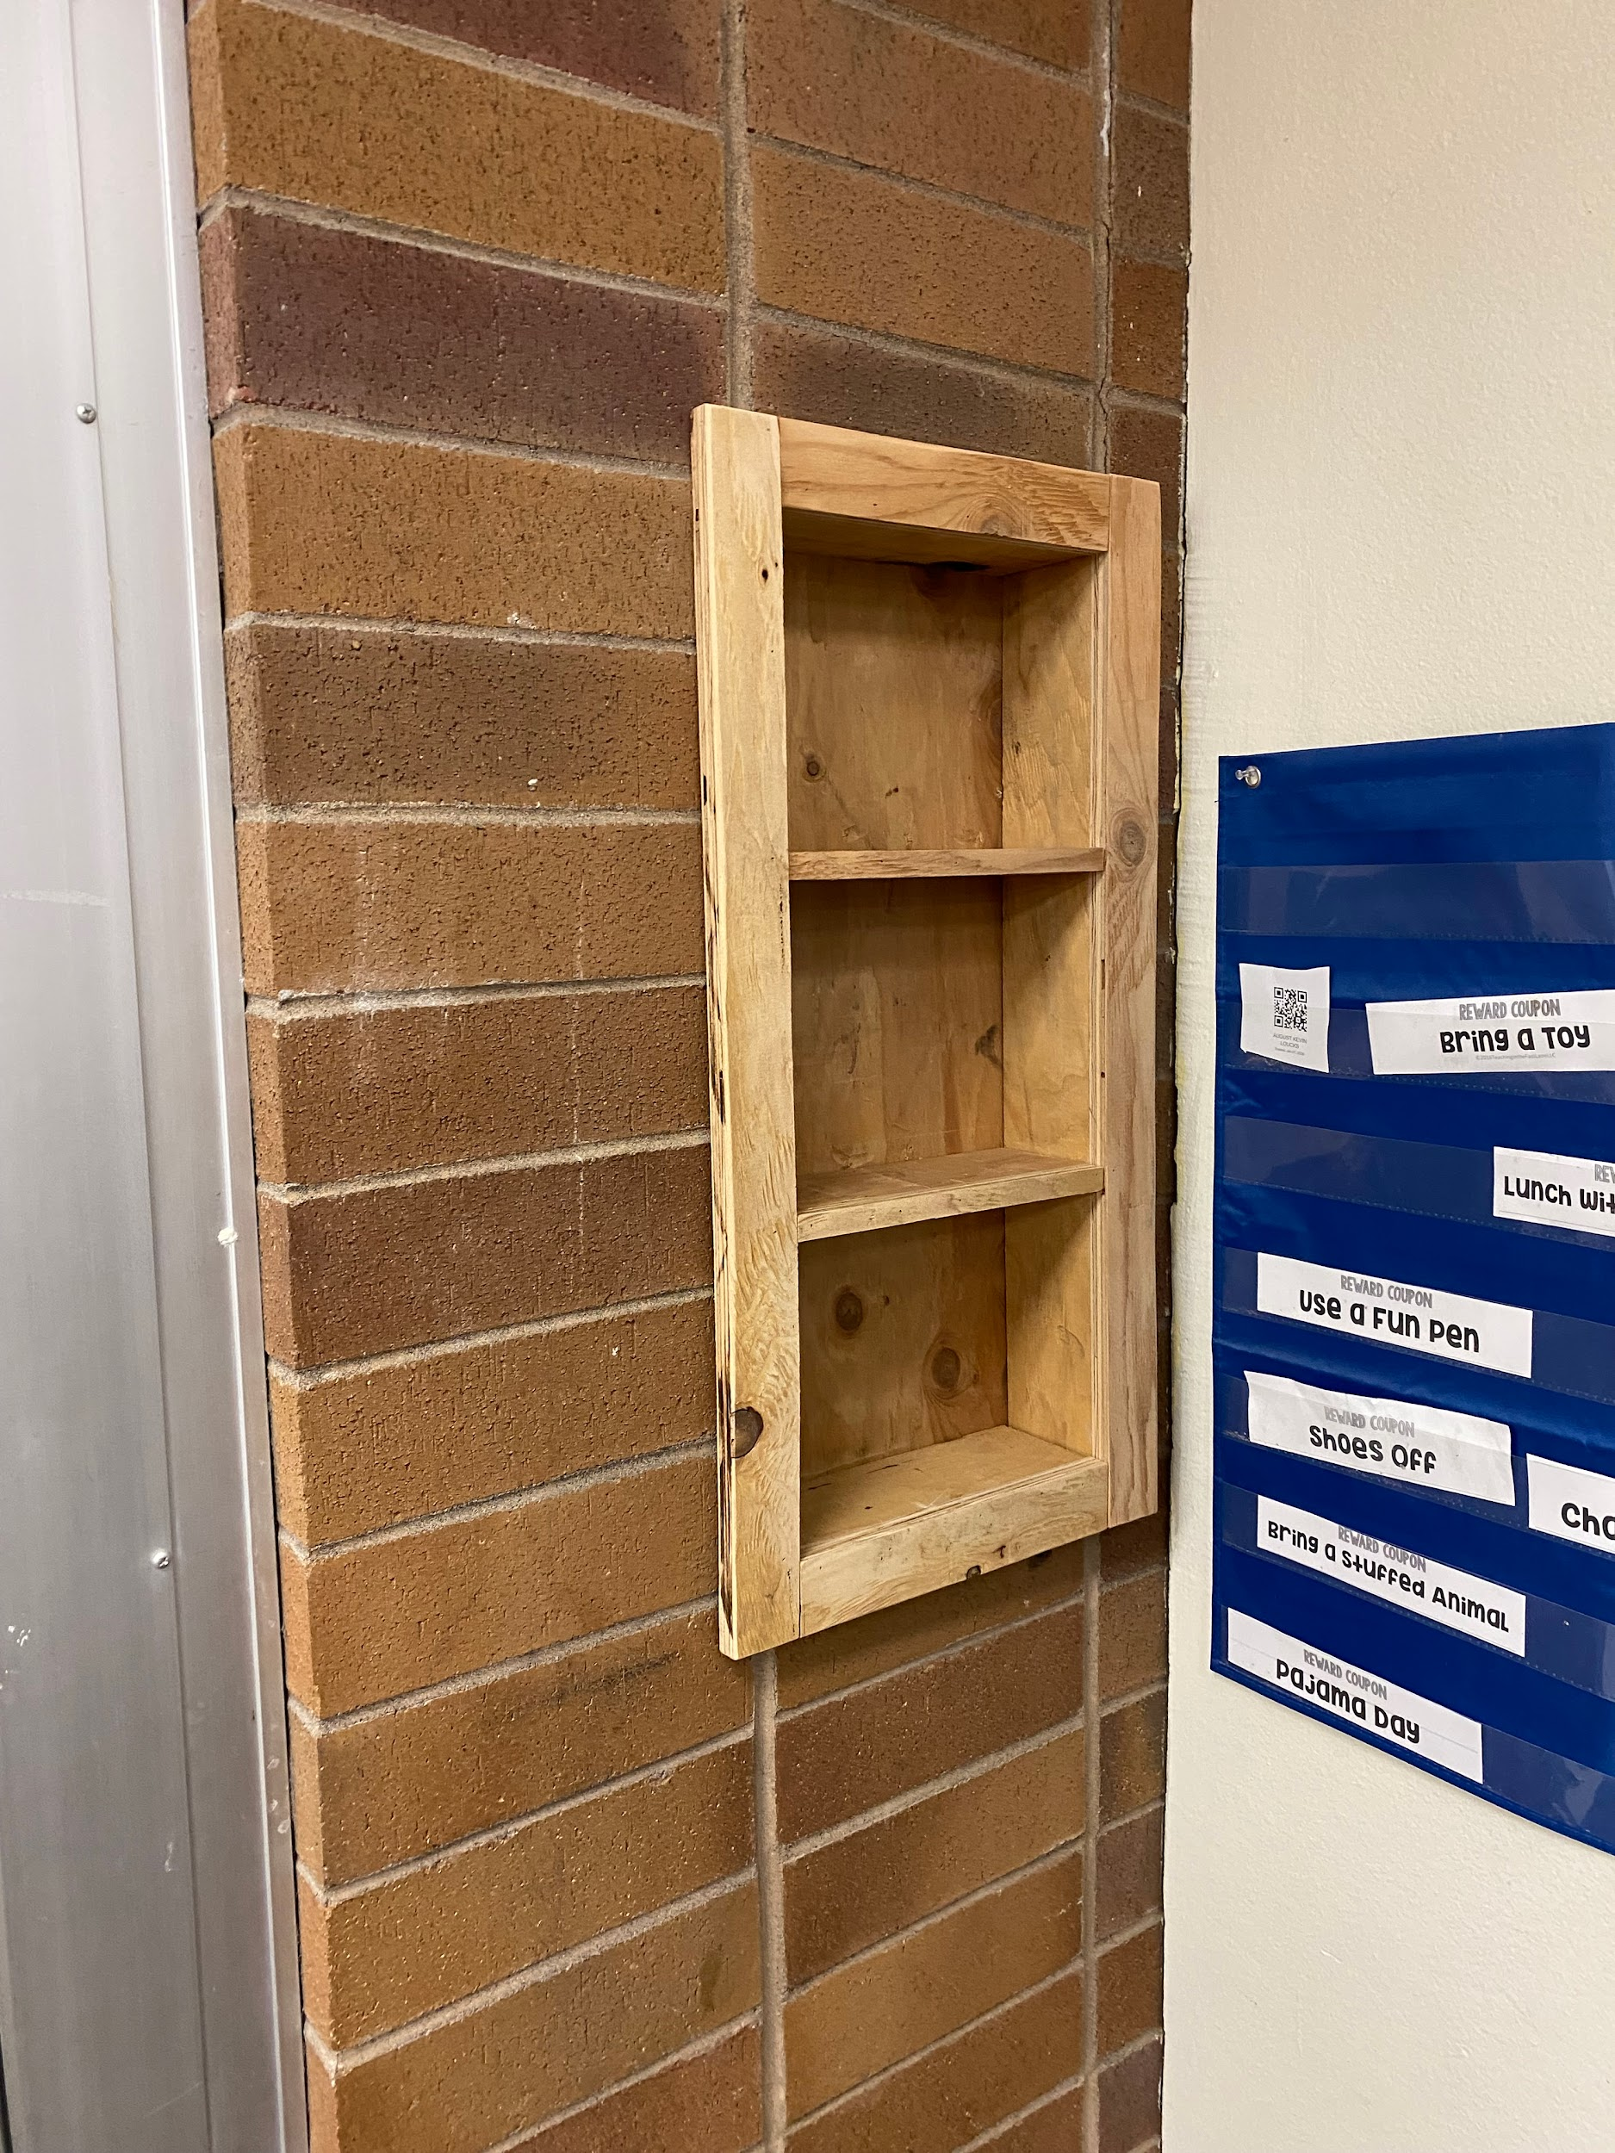
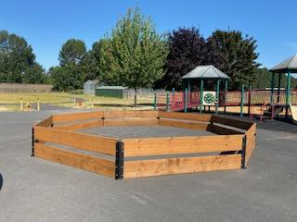
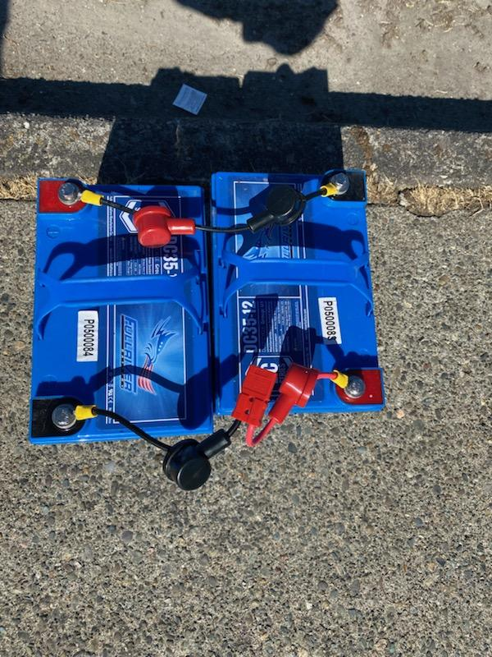
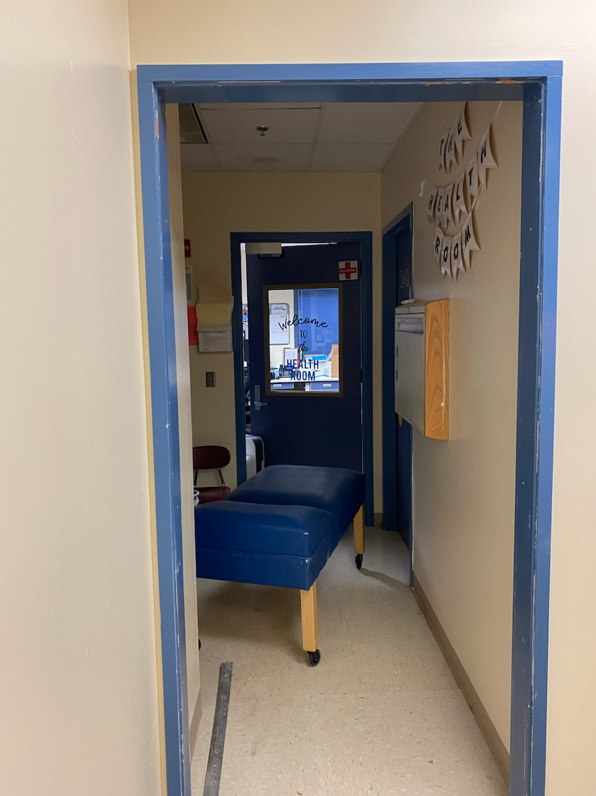
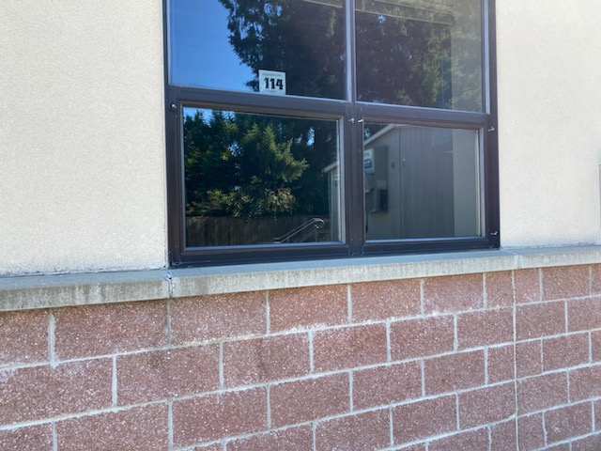
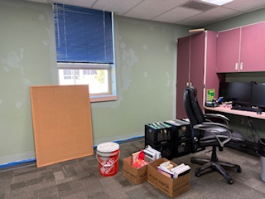
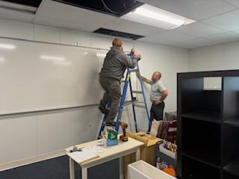
Maintenance Accomplishments
Yellow hall before and after maintenance personnel painted it
Damaged bricks repurposed into cubby areas for storage at CES
Replaced lights throughout the district
Created safety line of sight access for TEAM High with a new window
Built gaga ball pits at WMS, NFES, & CES
Replaced broken windows at NFES
Removed wall at NFES for nurse’s office
Installed new batteries for the scrubber at NFES
Painted the principal and assistant principal’s offices at WMS

Slide 6
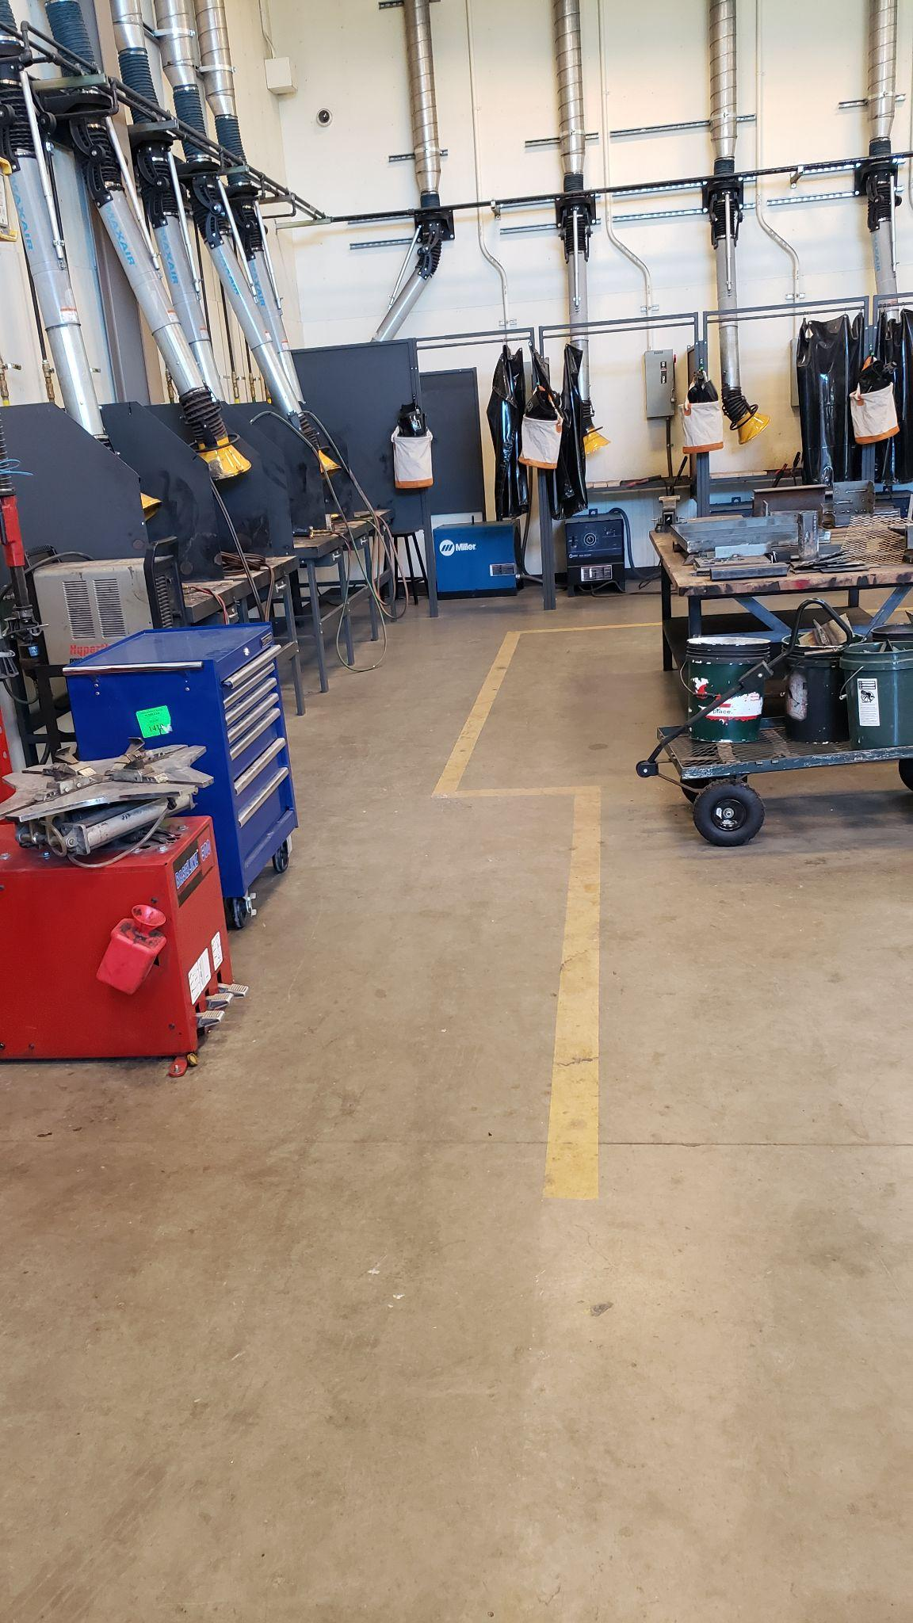
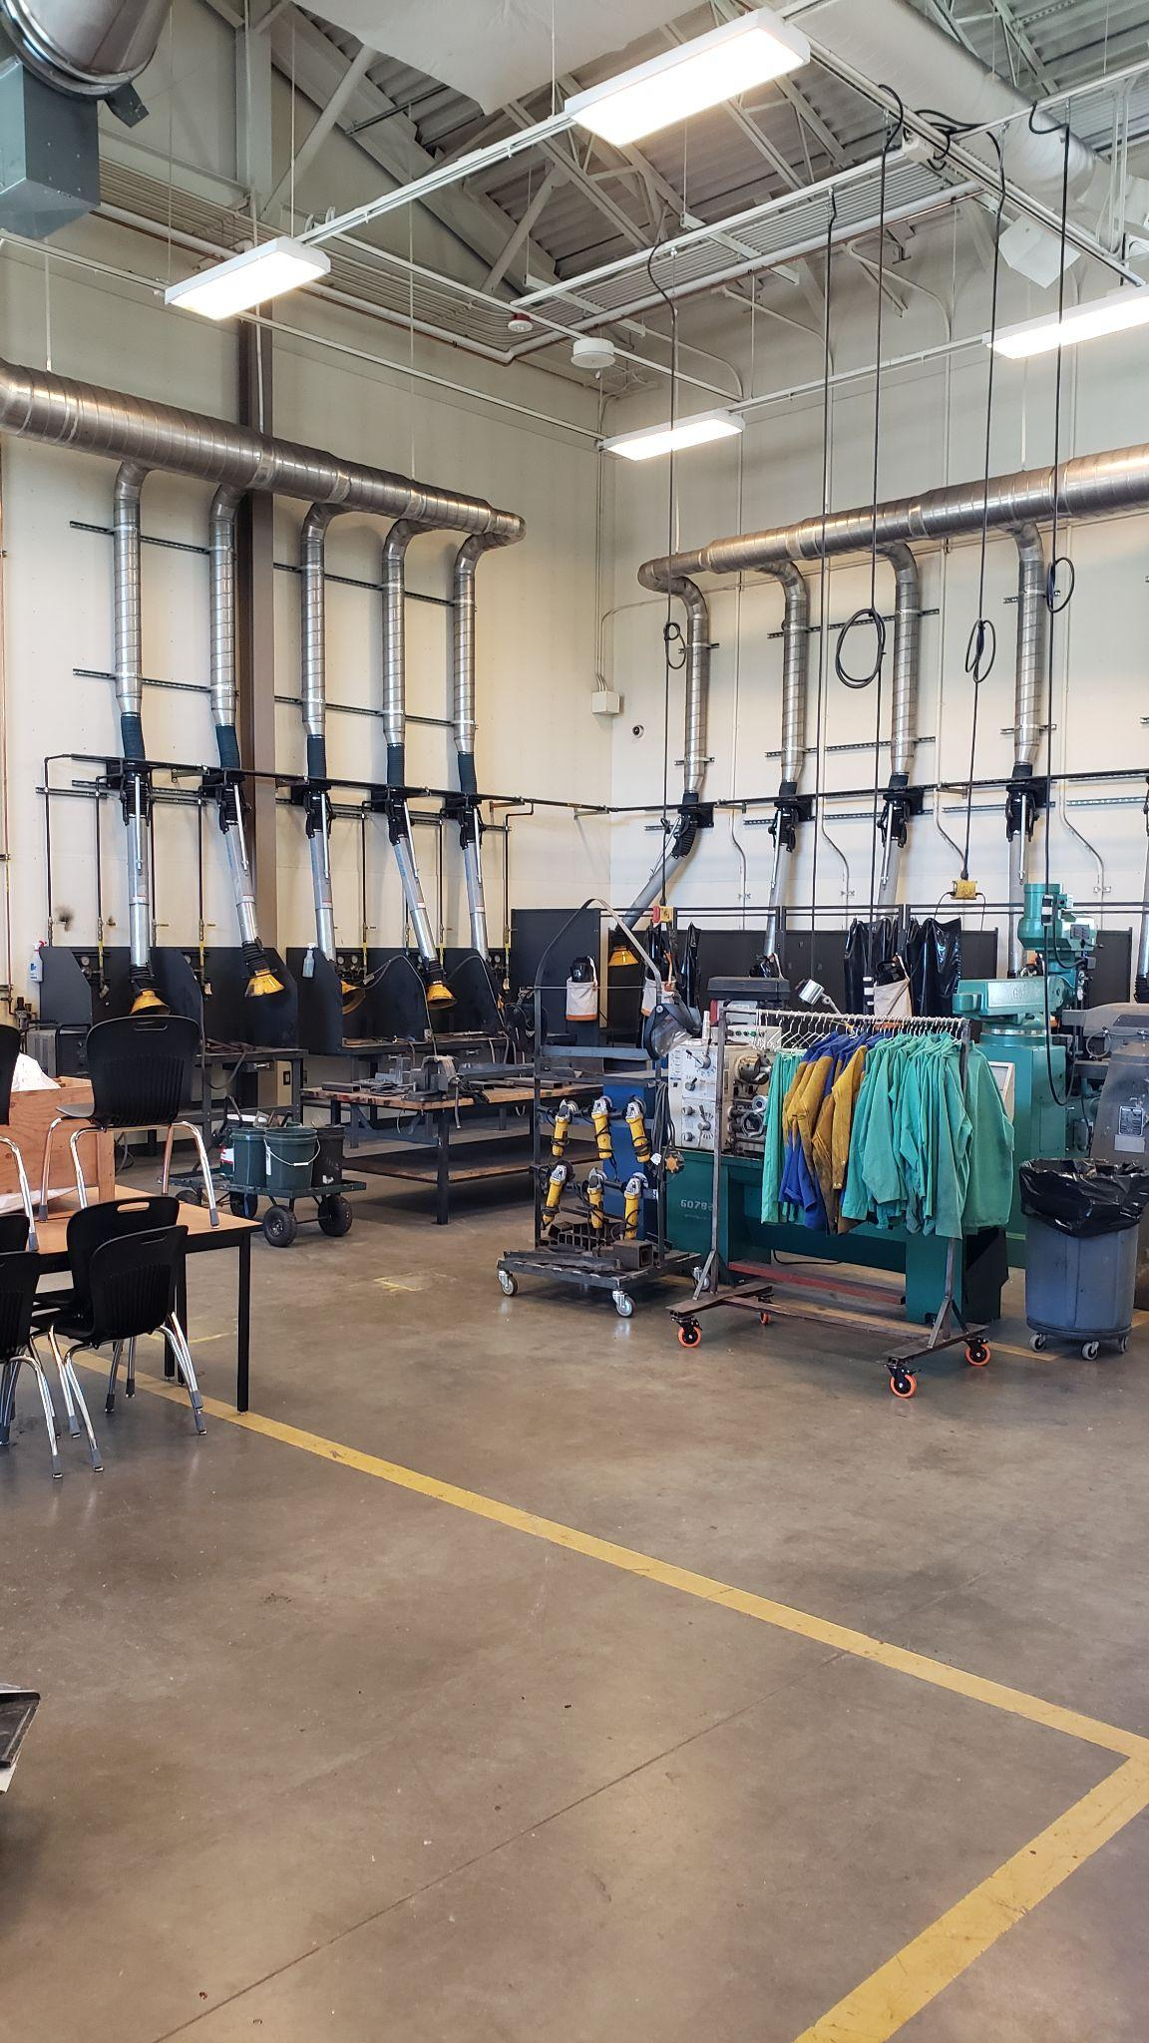
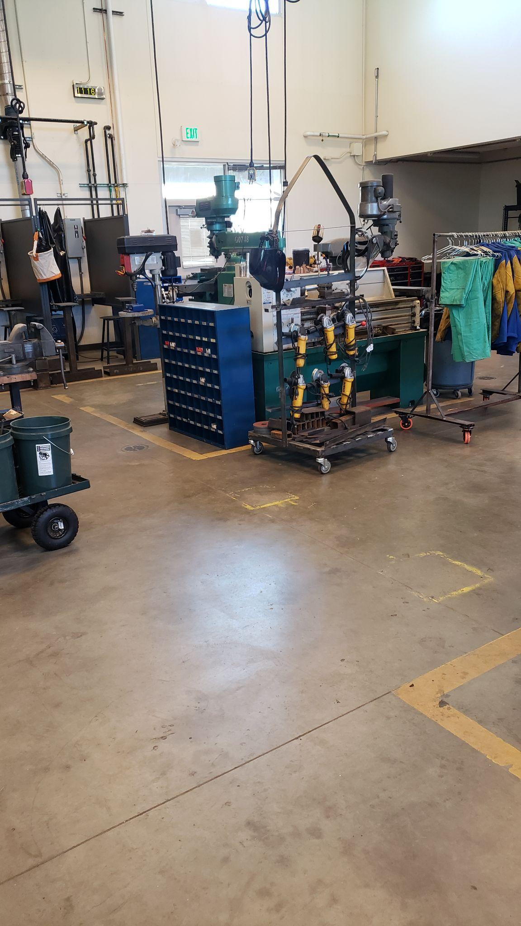
GOALS for Custodial Crew:
Deep clean
  Classrooms
  Office spaces
  Common spaces
  Bathrooms
Clean
  Monument signs
  Scoreboards
  Press boxes
  Storage areas
  Building mounted signs
Strip and refinish floors
Touch up paint and minor scuffs
Clean interior and exterior windows
Vacuum and shampoo carpets
Speciality clean for turnover:
  Principal and vice-principal’s offices at WMS
  Principal's office at CES

Slide 7
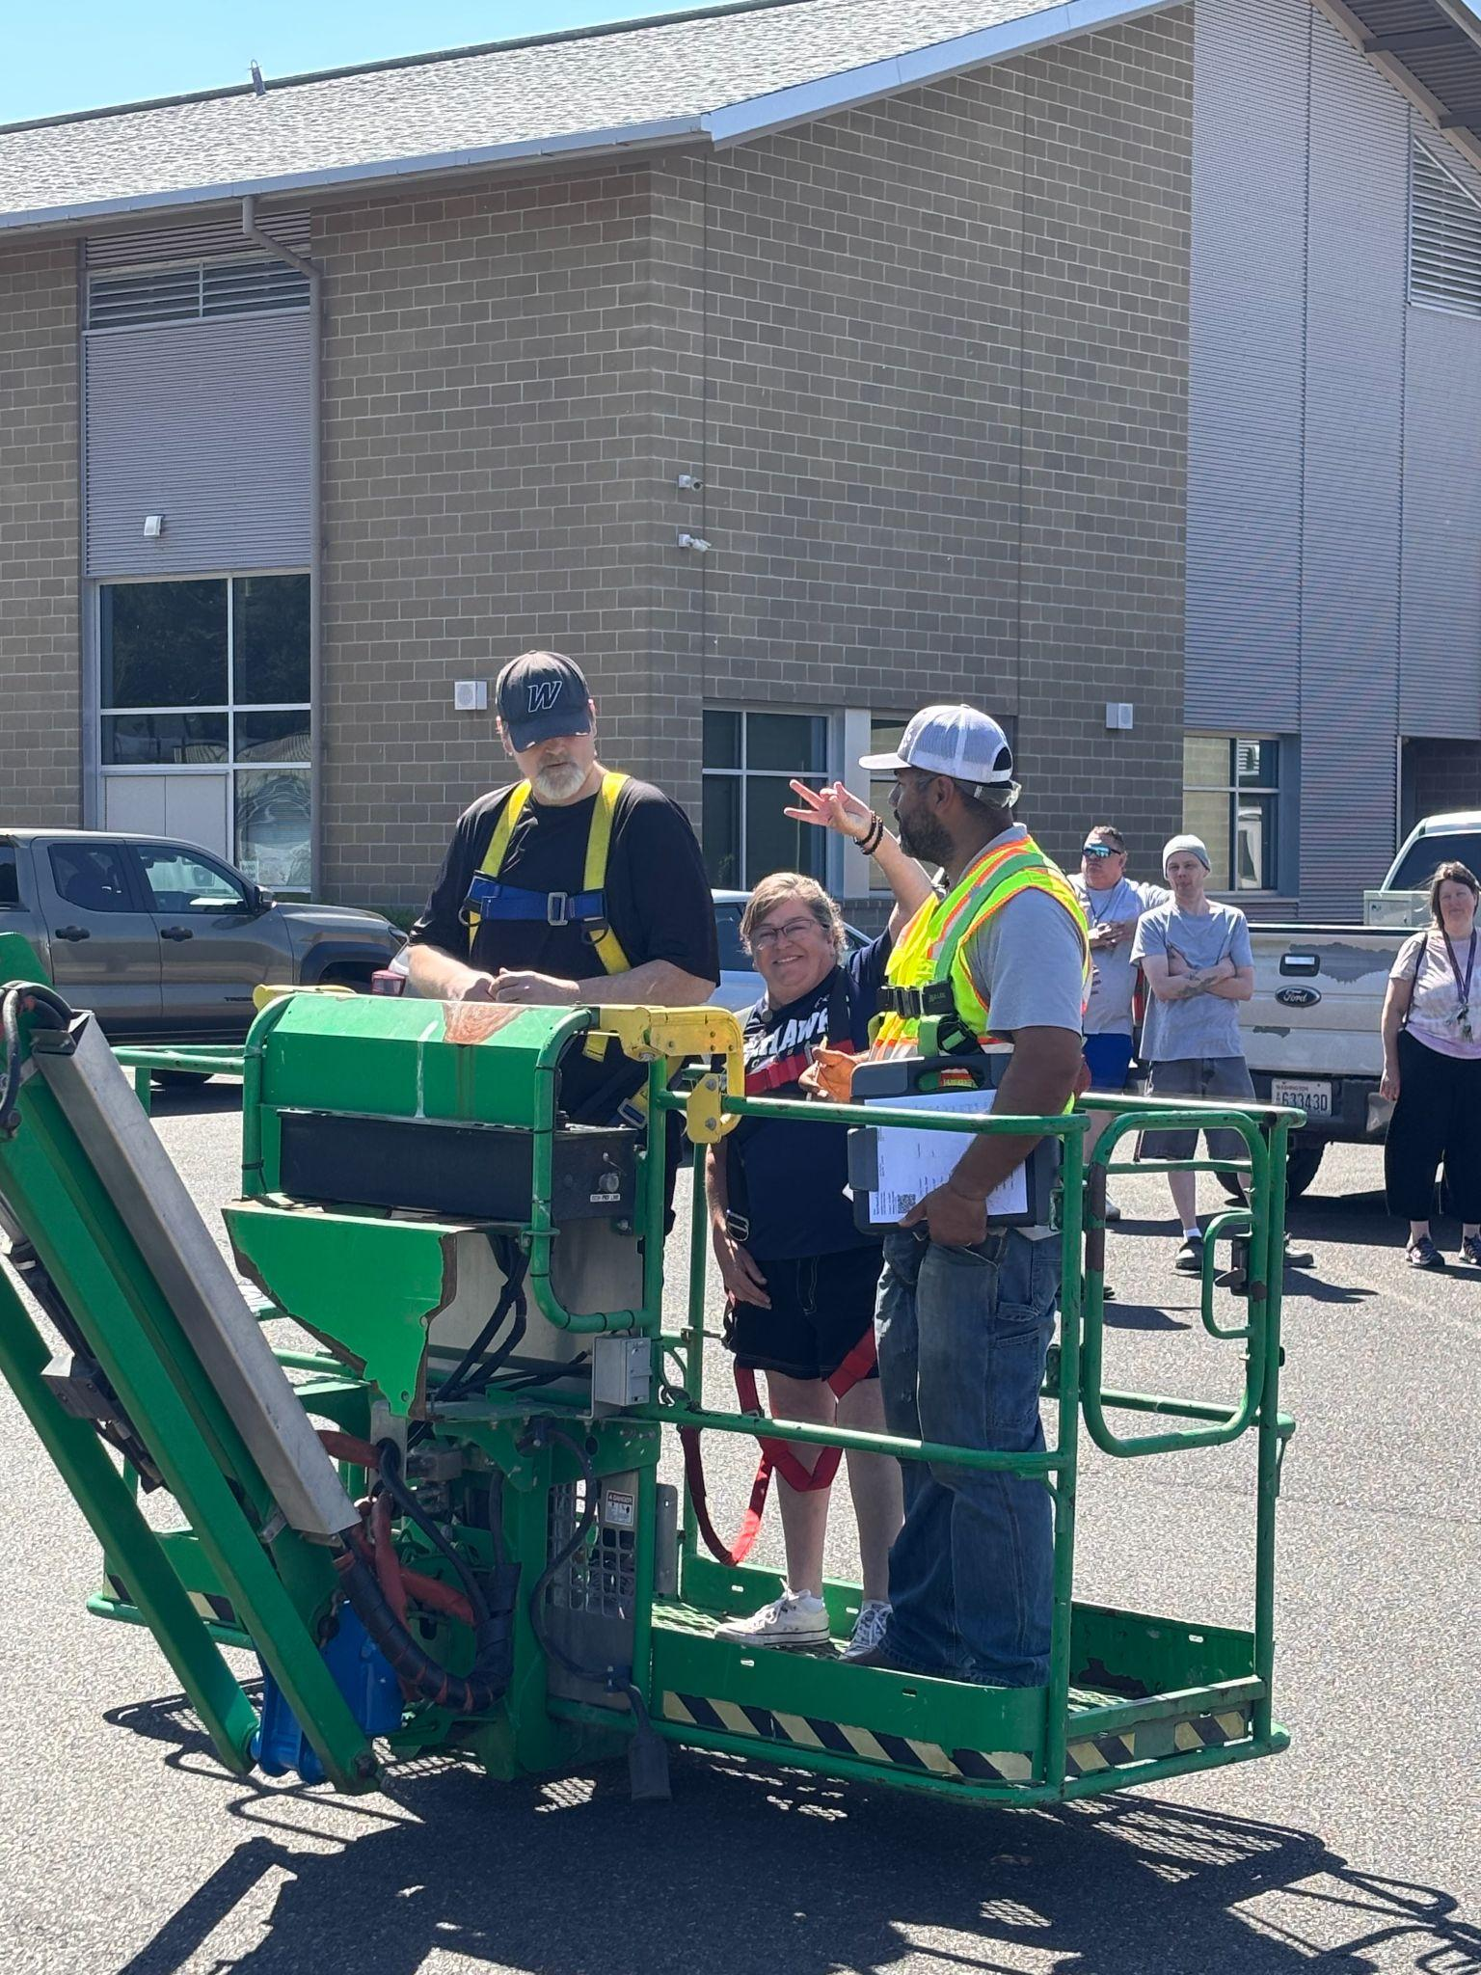
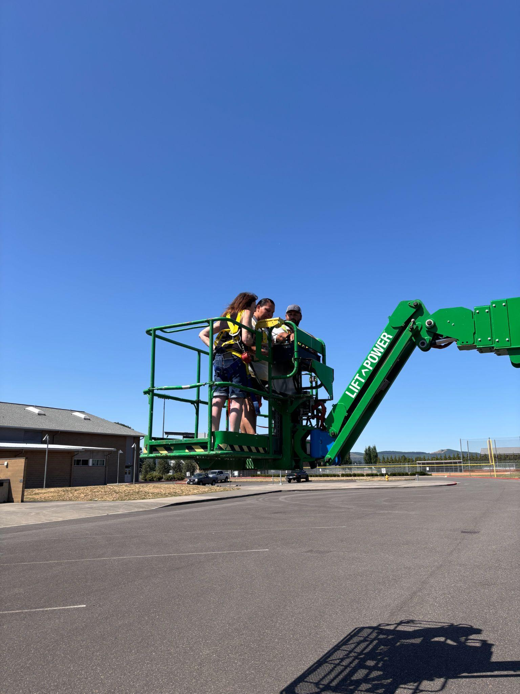
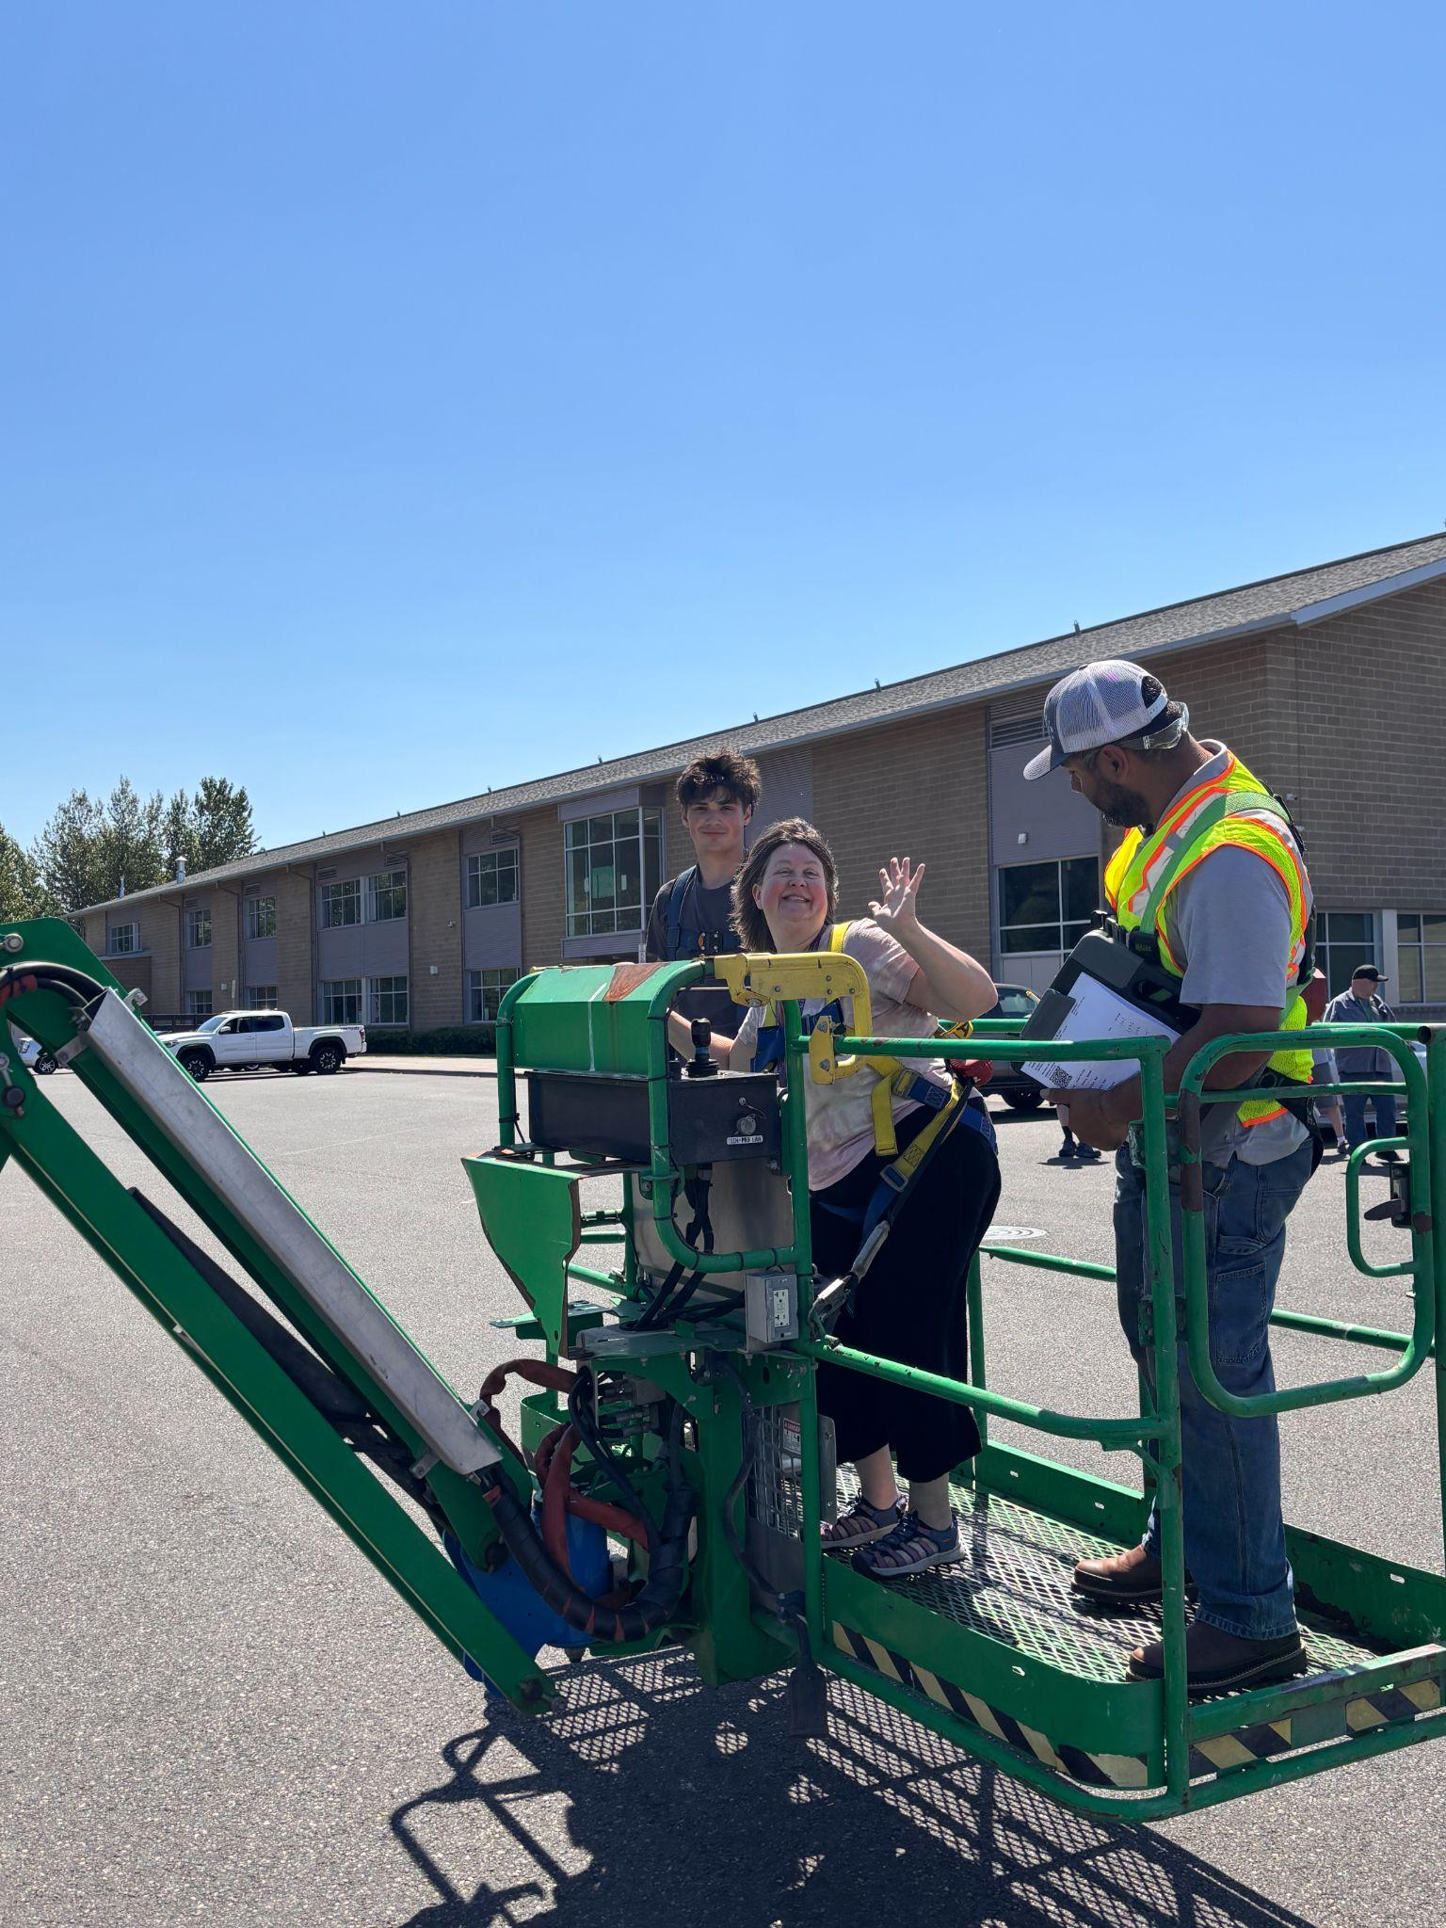
Custodial Crew ACCOMPLISHMENTS:
Emptied all classrooms to prepare for deep cleaning
Steam-cleaned all carpets through the district
Prepped, stripped, and refinished all floors that needed it
Deep cleaning of all classrooms, office spaces, common spaces
  Dusting
  Sanitizing
  Sinks
  Floors
  Lights and light fixtures
  Gum removal from desks
  Wiping down walls
Daily cleaning for locations still in use such as:
  WMS Commons
  Offices at WHS
  Bathrooms at all locations
  Tech Dept.
  TEAM High
  Sports Run at WHS
Aerial lift certified on both the scissor lift and boom lift
Patching and painting of minor scuffs and areas that needed it
Deep clean of WHS metal shop for turnover to new teacher
Assisting each other at different locations with deep cleaning as needed
Repairs on floor transitions
Moving furniture back into classrooms once cleaned
Custodial staff being trained on the boom lift

Slide 8
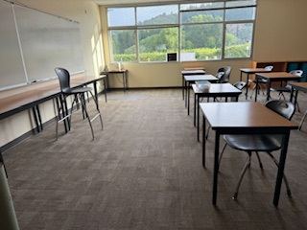
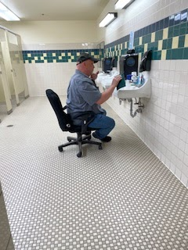
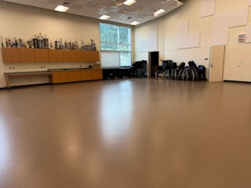
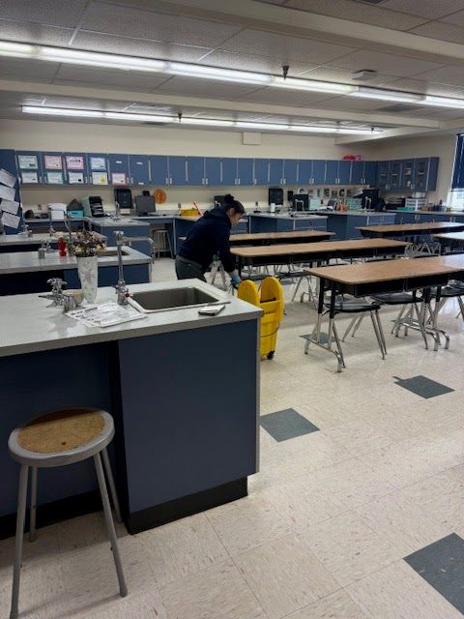
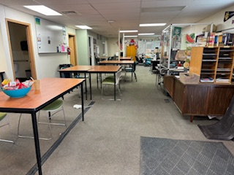
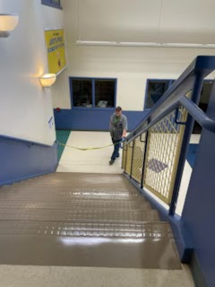
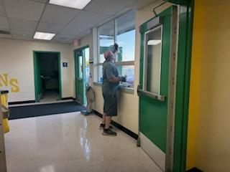
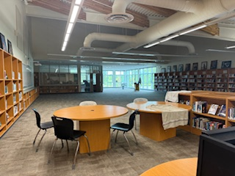
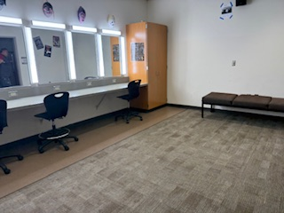
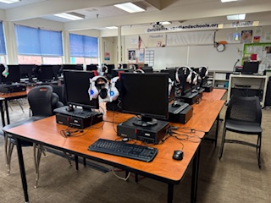
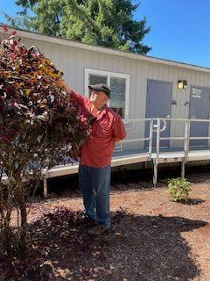
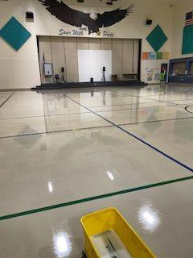
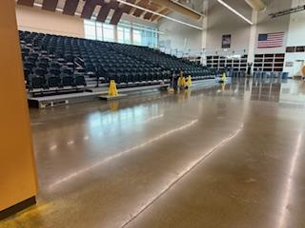
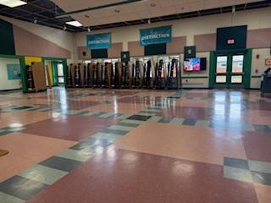
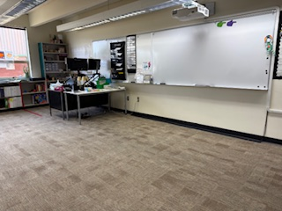
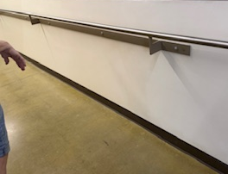
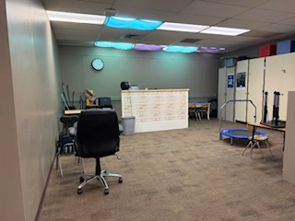
Custodial Accomplishments
B seen here deep cleaning science room in the yellow hall at WMS
TEAM High deep cleaning completed by Troy
The dance studio at WHS was deep cleaned by Odie
Deep cleaning completed at WHS in Room 1407
Lee deep cleaned bathrooms at NFES
Stairwell cleaning completed by Michelle and Lee
WHS library was deep cleaned by Chris
Lee landscaped at NFES
Green hall classroom deep cleaned by Joey
Michelle refinished floors at NFES
Troy cleaned windows at WMS
Dressing rooms at WHS deep cleaned by Odie
Frank kept the WMS Commons cleaned daily for summer meal times
Camille patched and painted damaged walls at WHS
WHS Commons deep cleaned by Camille
DSP room at WMS cleaned by Joey
Room 101 at CES deep cleaning completed by Kim

Slide 9














Custodial Accomplishments
One of the rooms deep cleaned by Chris at WHS
Kim cleaned carpets at CES
Frank cleaned carpets at WMS
Camille deep cleaned the offices in Student Services at WHS
Frank refinished the science room floors in the yellow hall at WMS
WMS yellow hallway right after school let out in June and ready for new students in August
Gum pulled from several desks at WHS by Tom
Camille deep cleaned the front counter and adjoining rooms in Student Services
Michelle cleaned stairwells at NFES
Michelle and crew refinished all the floors at NFES
The commons at WHS after being deep cleaned
A cleaned hallway floor at NFES
B deep cleaned classrooms

Slide 10



GOALS for Grounds Crew:
Touch up playground equipment and tighten fasteners
Remove and replace old fall areas in playgrounds
Sweep and re-stripe parking lots
Pressure wash
  Walkways
  Building masonry
  Signage
Beds and lawns
  Weed
  Edge
  Resurface (bark dust)
Pressure wash exterior greenhouse walls and roof
Weekly lawn mowing of all fields

Slide 11




Grounds Crew Accomplishments
Aerial lift certified on both the scissor lift and boom lift
Weekly mowing of all fields
Landscaping of all trees and shrubs at each school site
Repair of irrigation system at the high school after a leak was detected
Painted parking lot stripes at all school sites
Edging
Clean-up and resurfacing of all landscaped beds throughout the district with new bark dust
River rock installation at the high school
Moving curriculum to various school sites
Painting new field stripes
Weekly water treatments at Yale ES
Weekly irrigation of fields
Bark dusting throughout the district

Slide 12












Grounds Crew Accomplishments
Tim removed dirt and debris from the sidewalks at the middle school
The courtyard at CES after pressure washing, weeding, and general clean up
Before and After: Landscaping completed by Darin
Tree trimming was completed at WHS
Darin re-striped parking spots throughout the district
The district office after mowing, edging, landscaping, and pressure washing.

Slide 13












Grounds Crew Accomplishments
The Grounds Crew was kept busy all summer with weekly mowing, watering, repainting of all the parking stalls across the district, landscaping of all shrubbery and trees, and an irrigation fix at the HS.

Slide 14

GOALS for Summer Help:
Clean and reset lockers
Pressure wash all
  Walkways
  Building masonry
  Signage
Help weed, edge, resurface all beds and lawns
Assist with classroom moves

Slide 15


Summer Help Accomplishments
Completed removal of furniture from each classroom so that custodians could begin cleaning
Assisted with moving preschool from NFES to CES portable 6
Locker combination resets, dusting, and deep cleaning
Prepping sidewalks for pressure washing
Pressure washing
Prepping CES and NFES playgrounds for bark dust deliveries
River rock landscaping at highschool
Edging at all school sites
Cleaning up flower beds at NFES
Aerial lift certification on scissor lift and boom lift
Interior and exterior window washing at all school sites
Cleaning as assigned by custodian
Moving furniture back into classrooms at each school site

Slide 16











Summer Help Accomplishments
Jaqulynn landscaped with bark dust at NFES
Chase moving classroom furniture.
Tory and Jennette at NFES.
Tammy resetting locker combos and cleaning lockers at the middle school.
Lily cleaned windows at NFES with the boom lift
Lily cleaning windows at the high school using the boom lift.
Jennette vacuuming rooms at NFES.
Tory washing windows at the middle school.
Lily scraping weeds out of cracks at CES.
Lily helping out with cleaning at NFES.
Adam pressure washing the “W” at the stadium at the high school.

Slide 17












Summer Help Accomplishments
Summer help loaded up pressure washers to be used at the WHS
Tory pressure washed the sidewalks at the high school.
Lily washing windows at the high school.
Jennette removed debris from the sidewalks at NFES
Adam pressure washing the front entrance of the high school.
Ty assisted Troy with replacing carpet at WMS
Adam pressure washed at NFES
Adam pressure washed the greenhouse at the high school.
Jennette adjusting desks at NFES.
Jaqulynn and Jennette completed bark dusting at NFES
Chase and Tory landscaping with river rock at the high school.
Tory edging the grass at the high school.

Slide 18
Additional Projects Completed
New roofing completed on portables 462 and 463 at WMS
New carpet in the following rooms:
  CES-203, 204, 207, 208, 209, 212, & 213
  NFES- 104, 105, 112, 212
Re-striping of all crosswalks, handicap parking stalls, and curbs throughout the district
Construction of IQ Credit Union teller window at WHS
Removal of several widowmaker trees throughout the district
Refinishing of the following gym floors:
  WHS Aux Gym
  WHS Main Gym
  WMS Green Gym
  WMS Yellow Gym
New bark dust blowing at:
  NFES playgrounds
  CES playgrounds
  Yale playground

Slide 19









Additional Projects Completed
Yale ES playground before and after new bark dust
CES playgrounds before and after new bark dust
NFES playgrounds before and after new bark dust

Slide 20










Additional Projects
NFES Room 104 carpet before and after replacement
CES Room 207 before and after carpet replacement
Both gyms at WMS had their floors refinished
New roofs on two portables at NFES-Exterior painting still to be done
New portable was installed at NFES
Both gym floors refinished at WHS
All crosswalks, curbs, speed bumps, and handicap parking spots were given fresh paint

Slide 21




Summer 2025 Employees of the Week
Joey Asmus
Swing Custodian
Green Hall
WMS
Chris Lefever
Swing Custodian
Second Floor & Library
WHS
Frank Springer
Day Custodian
WMS
Michelle Worley
Day Custodian
NFES
Lee Kouvo
Swing Custodian
NFES
L. Camille Wilson
Day Custodian
WHS
Troy Maynard
Swing Custodian
WMS
Maintenance: Daniel Blottenberger & Carlos Urbina
Grounds: Darin Holmes & Tim Haines

Slide 22





Thank You!
A huge thank you to the citizens of Woodland, Woodland Public Schools School Board, and the administration here at Woodland Public Schools, for giving Facilities the means to accomplish all of this work this summer.
A special thank you to Facilities custodial vendor, Buckeye, for donating enough funds to treat the Facilities and Tech staff to a end of summer luncheon.

